Slide 1
Intro to Digital Forensics and Incident Response
Karanbir “K” Singh

Slide 2
Who am I?
Some random student @ CPP
Cyber Investigations and Discovery Services Intern @ Kaiser Permanente
Professional Services Intern @ Blackberry | Cylance
Director of the Student-Run SOC @ CPP
WRCCDC Black team member
Garage mechanic

Slide 3
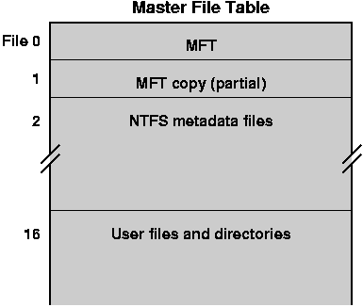
Quick Definitions
MFT-Master File Table
Carving
Chain of Custody
Checksums/Hashes

Slide 4
What is Digital Forensics
“Recovery and Investigation of data found on Electronic Devices.”
Phones, Tablets, Laptops/Desktops, Cameras, etc.
Evidence is presented in a court of law.
Possibly handed off to E-Discovery Specialists
Usage of “carving” in order to find deleted/hidden/partially-erased files.
This is how you’re actually supposed to CSI:Miami.

Slide 5
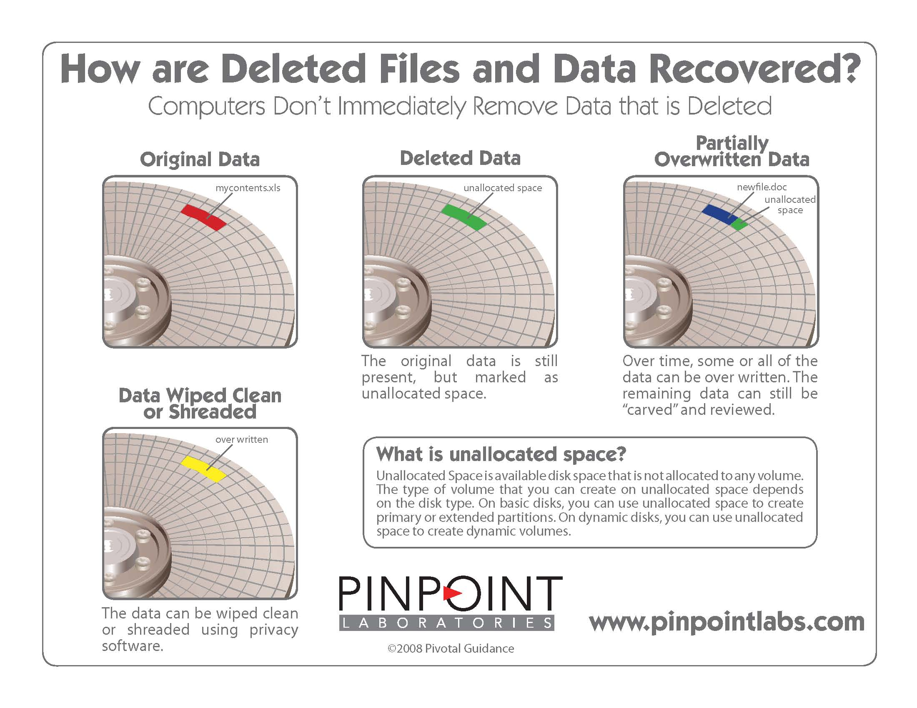

Slide 6
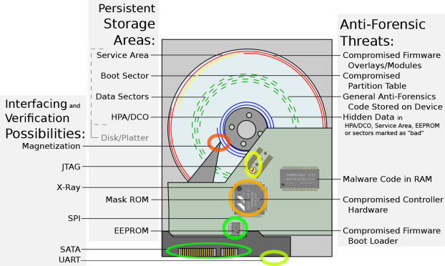

Slide 7
Software Used
EnCase
FTK Imager/Toolkit
Sleuth Kit & Autopsy
SANS SIFT
CAINE
NUIX
Magnet AXIOM
BlackBag BlackLight & Macquisition
Intella
Cellebrite
X-Ways

Slide 8
Hardware Used
Write Blockers
Imaging Stations
Cellebrite
Paraben Faraday bags

Slide 9
Forensic Process
Seizure
Imaging
Analysis
Timelining
Report & Impact

Slide 10
Seizure
Machine may be imaged or sent directly to the lab.
Virtual Machine might be snapshot and sent to the lab.
Live forensics on-site.

Slide 11
Imaging
Imaged via write blocker
Pre-made image provided by client.
VDMK from a Virtual Machine
.E01, .AFF, .RAW

Slide 12
Analysis
Image tossed through software of choice.
Many hours spent screaming at a bundle of binary.
Files may manually have to be carved out.

Slide 13
Timelining
Million line excel made.
Details a list of events pertinent to the investigation.
Event Logs, User Activity, Possible Exfil or Lateral Movement

Slide 14
Report and Impact
Details exactly what the user/threat actor did.
Details impact on the organization as a whole.
Contains future mitigation steps.

